Slide 1
TalkingData AdTracking Fraud Detection Challenge

Slide 2
Contents Table
0. Overview
1. Data Exploration
Method1
Method2
Method3
2. Data Preprocessing
3. Target Variable Prediction
4. Conclusion

Slide 3
0. Overview
Description
TalkingData, China’s largest independent big data service platform, covers over 70% of active mobile devices nationwide. They handle 3 billion clicks per day, of which 90% are potentially fraudulent. The goal of the competition is to create an algorithm that predicts whether a user will download an app after clicking a mobile app ad.
Evalution
Submissions are evaluated on area under the ROC curve between the predicted probability and the observed target.

Slide 4
0. overview
variables
ip : ip address of click
app : app id for marketing
device : device type id of user mobile phone
os : os version id of user mobile phone
channel : channel id of mobile ad publisher
click_time : timestamp of click (UTC)
attributed_time : if user download the app for after clicking an ad, this is the time of the app download
is_attributed : the target that is to be predicted, indicating the app was download

Slide 5
1. Data Exploration
Explore 100,000 data
Check download frequency
ip : 100000 non-null int64
app : 100000 non-null int64
device : 100000 non-null int64
os : 100000 non-null int64
channel : 100000 non-null int64
click_time : 100000 non-null datetime64
attributed_time : 227 non-null object
is_attributed : 100000 non-null int64
0 : 99773
1 : 227
download proportion : 0.00227

Slide 6
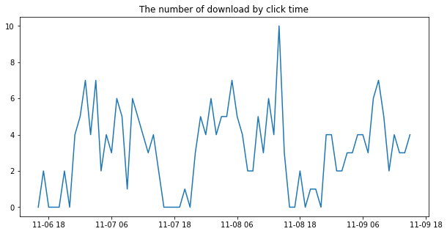
1. Data Exploration
Check the number of download by click time

Slide 7
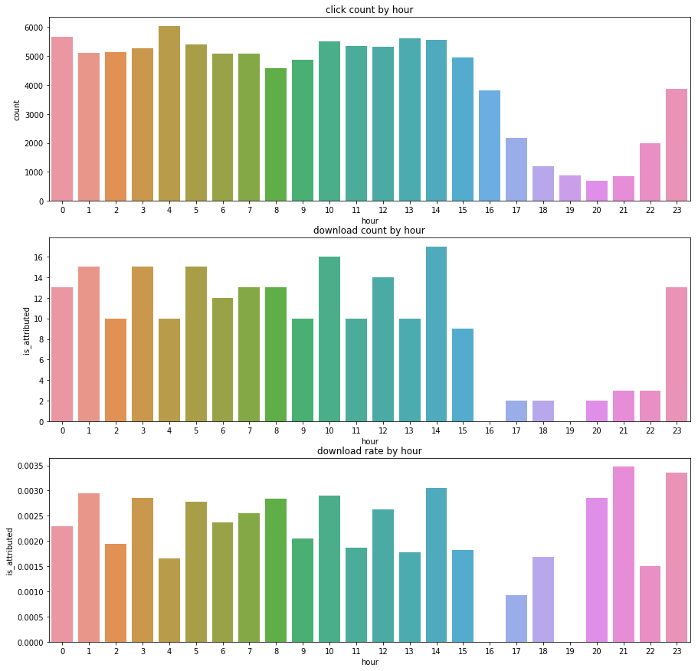
1. Data Exploration
Check click count per hour

Slide 8
1. Data Exploration
Check download count per hour

Slide 9
1. Data Exploration
Check download rate per hour

Slide 10
1. Data Exploration
Check click count, download count, download rate (by app, device, os, channel)
Don’t put the graph here because it is so large.
Please refer to the address below to view it.
https://github.com/MinPinSunHwa/Ad_Tracking_Project

Slide 11
1. Data Exploration
Check correlation
ip : 0.053833
app : 0.059722
device : 0.001630
os : 0.001630
channel : -0.024133
hour : -0.005629

Slide 12
Method1

Slide 13
2. Data Preprocessing
Train all data
Make derived variables
Create derived variables in each train all dataset and train sample dataset.
A total of 14 derived variables are created.
hour : hour from click time
preprocessing
Train sample data
preprocessing

Slide 14
2. Data Preprocessing
Train all data
Make derived variables
# : download proportion
ip_attr_prop : # by ip
app_attr_prop : # by app
device_attr_prop : # by device
os_attr_prop : # by os
channel_attr_prop : # by channel
hour_attr_prop : # by hour
tot_attr_ptop : the sum of the above 6 variables
preprocessing
Train sample data
preprocessing

Slide 15
2. Data Preprocessing
Train all data
Make derived variables
# : download proportion
ip_hour_prop : # by ip and hour
ip_app_prop : # by ip and app
ip_channel_prop : # by ip and channel
hour_app_prop : # by hour and app
hour_channel_prop : # by hour and channel
tot_vv_prop : the sum of the above 5 variables
preprocessing
Train sample data
preprocessing

Slide 16
2. Data Preprocessing
Train all data
Check correlation
ip_attr_prop : 0.438892
app_attr_prop : 0.444209
device_attr_prop : 0.201987
os_attr_prop : 0.226293
channel_attr_prop : 0.389942
hour_attr_prop : 0.008851
tot_attr_ptop : 0.532482
preprocessing
Train sample data
preprocessing

Slide 17
2. Data Preprocessing
Train all data
Check correlation
ip_hour_prop : 0.582208
ip_app_prop : 0.755585
ip_channel_prop : 0.715354
hour_app_prop : 0.457047
hour_channel_prop : 0.416602
tot_vv_prop : 0.739013
preprocessing
Train sample data
preprocessing

Slide 18
2. Data Preprocessing
Train all data
Preprocess test data
Based on train all dataset except ‘hour’ variable, 13 derived variables are created in the test dataset.
Because train all dataset is the most data, the value of the test dataset can be filled without as many blanks as possible, thus creating derived variables in the test dataset using train all dataset.
Test data
preprocessing

Slide 19
3. Target Variable Prediction
Create functions
Create functions prior to prediction of the target variable.
check_data : To check data distribution
examine_outlier : To check for values other then 0 and 1

Slide 20
3. Target Variable Prediction
Train all data
Test data
preprocessing
preprocessing
Predict target
Train sample data
Train a model
preprocessing

Slide 21
3. Target Variable Prediction
Create features to use a model
feat1 = ip_attr_prop, app_attr_prop, device_attr_prop, os_attr_prop, channel_attr_prop,
hour_attr_prop, tot_attr_prop
feat2 = ip_hour_prop, ip_app_prop, ip_channel_prop, hour_app_prop, hour_channel_prop,
tot_vv_prop
feat3 = feat1 + feat2
feat4 = ip_attr_prop, app_attr_prop, channel_attr_prop, tot_attr_prop
feat5 = feat4 + feat2
feat6 = app_attr_prop, channel_attr_prop, hour_app_prop, hour_channel_prop

Slide 22
3. Target Variable Prediction
Predict target variable
Linear Regression
Ridge
Logistic Regression
Decision Tree
Random Forest
Gradient Boosting
K-Nearest Neighbors
Support Vector machines
LightGBM
Skip because it takes too long

Slide 23
3. Target Variable Prediction
Predict target variable
Linear Regression
 | 10m | 20m | 30m
feat1 | 0.9336475 | 0.3937085 | 0.9396936
feat2 | 0.7903207 | 0.7990348 | 0.8090254
feat3 | 0.6832881 | 0.6891693 | 0.6870306
feat4 | 0.9394377 | 0.9393066 | 0.9394337
feat5 | 0.6786381 | 0.6730954 | 0.6829231
feat6 | 0.9467690 | 0.9468087 | 0.9466697
10m, 20m, 30m : 10, 20, 30 million train data
The value in table : kaggle score (AUC)

Slide 24
3. Target Variable Prediction
Predict target variable
Logistic Regression
C | 10m | 20m | 30m
0.01 | 0.9518560 | 0.9518226 | 0.9518260
0.1 | 0.9517896 | 0.9518113 | 0.9517822
1 | 0.9517904 | 0.9517846 | 0.9517540
10 | 0.9517882 | 0.9517830 | 0.9517553
feature : feat6

Slide 25
3. Target Variable Prediction
Predict target variable
Decision Tree
max_depth | 10m | 20m | 30m
3 | 0.9039194 | 0.9039806 | 0.9040380
4 | 0.9068583 | 0.9065484 | 0.9067215
5 | 0.9379549 | 0.9245333 | 0.9310434
feature : feat6

Slide 26
3. Target Variable Prediction
Predict target variable
Random Forest
n_estimators max_depth | 30 | 50 | 70
3 | 0.9117286 | 0.9325352 | 0.9325768
4 | 0.9446114 | 0.9444698 | 0.9481182
5 | 0.9511519 | 0.9506940 | 0.9506489
feature : feat6
sample : 10m
max_features : 1

Slide 27
3. Target Variable Prediction
Predict target variable
Gradient Boosting
n_estimators max_depth | 30 | 50
3 | 0.9058254 | 0.9069254
4 | 0.9426463 | 0.9432340
5 | 0.9477711 | 0.9486383
feature : feat6
sample : 10m
learning_rate : 0.01

Slide 28
3. Target Variable Prediction
Predict target variable
LightGBM
 | 10m | 20m | 30m
feat1 | 0.9426481 | 0.9411704 | 0.9398357
feat2 | 0.8694790 | 0.8232350 | 0.8775217
feat3 | 0.8694790 | 0.8467034 | 0.8577380
feat4 | 0.9410401 | 0.9413678 | 0.9411245
feat5 | 0.8921562 | 0.8471011 | 0.8415991
feat6 | 0.9514271 | 0.9528658 | 0.9526517

Slide 29
Method2

Slide 30
2. Data Preprocessing
Train all data
Make and fill a variable ‘is_attributed’ in test data
Make a variable ‘is_attributed’ in test data, then fill the variable with the proportion of download in train data
Test data
Merge train data and test data
Combine train data and test data to make derived variables together.
merge

Slide 31
2. Data Preprocessing
Train all data
Make derived variables
Create 21 derived variables in merged dataset.
After preprocessing separate dataset, then extract a sample.
14 derived variables made in method1
Test data
preprocessing

Slide 32
2. Data Preprocessing
Train all data
Make derived variables
# : download proportion among download
ip_attr_tot_prop : # by ip
app_attr_tot prop : # by app
device_attr_tot_prop : # by device
os_attr_tot_prop : # by os
channel_attr_tot_prop : # by channel
hour_attr_tot_prop : # by hour
tot_attr_tot_ptop : the sum of the above 6 variables
Test data
preprocessing

Slide 33
2. Data Preprocessing
Train all data
Check correlation
ip_attr_prop : 0.438472
app_attr_prop : 0.442714
device_attr_prop : 0.235278
os_attr_prop : 0.226075
channel_attr_prop : 0.389457
hour_attr_prop : 0.007377
tot_attr_ptop : 0.547662
Test data
preprocessing

Slide 34
2. Data Preprocessing
Train all data
Check correlation
ip_attr_tot_prop : -0.003495
app_attr_tot_prop : 0.235278
device_attr_tot_prop : -0.044279
os_attr_tot_prop : -0.001541
channel_attr_tot_prop : 0.264980
hour_attr_tot_prop : 0.007057
tot_attr_tot_ptop : 0.026574
Test data
preprocessing

Slide 35
2. Data Preprocessing
Train all data
Check correlation
ip_hour_prop : 0.581782
ip_app_prop : 0.753387
ip_channel_prop : 0.713664
hour_app_prop : 0.452420
hour_channel_prop : 0.413714
tot_vv_ptop : 0.739452
Test data
preprocessing

Slide 36
3. Target Variable Prediction
Train all data
Train sample data
Train all data
train a model
Test data
extraction
Test data
Predict target
merge and preprocessing
separation

Slide 37
3. Target Variable Prediction
Create features to use a model
feat1 = ip_attr_prop, app_attr_prop, device_attr_prop, os_attr_prop, channel_attr_prop,
hour_attr_prop, tot_attr_prop
feat2 = ip_hour_prop, ip_app_prop, ip_channel_prop, hour_app_prop, hour_channel_prop,
tot_vv_prop
feat3 = feat1 + feat2
feat4 = ip_attr_prop, app_attr_prop, channel_attr_prop, tot_attr_prop
feat5 = feat4 + feat2
feat6 = feat5 + app_attr_tot_prop, channel_attr_tot_prop

Slide 38
3. Target Variable Prediction
Create features to use a model
feat7 = app_attr_prop, channel_attr_prop, hour_app_prop, hour_channel_prop
feat8 = feat7 + app_attr_tot_prop, channel_attr_tot_prop
feat9 = app_attr_prop, device_attr_prop, os_attr_prop, channel_attr_prop, hour_attr_prop
feat10 = feat9 + hour_app_prop, hour_channel_prop
feat11 = feat10 + app_attr_tot_prop, channel_attr_tot_prop

Slide 39
3. Target Variable Prediction
Predict target variable
LightGBM
LightGBM : add categorical_feature (app, channel)
Mean of the highest 3 scores

Slide 40
3. Target Variable Prediction
Predict target variable
LightGBM
 | 40m
feat1 | 0.5688519
feat2 | 0.7514380
feat3 | 0.5293284
feat4 | 0.5320984
feat5 | 0.2968826
feat6 | 0.6316038

Slide 41
3. Target Variable Prediction
Predict target variable
LightGBM
 | 10m | 20m | 30m | 40m | 50m
feat7 | 0.9509782 | 0.9519082 | 0.9505800 | 0.9509782 | 0.9520227
feat8 | 0.9538612 | 0.9527098 | 0.9525610 | 0.9532771 | 0.9525889
feat9 | 0.9572276 | 0.9550265 | 0.9568368 | 0.9532595 | 0.9556014
feat10 | 0.9501722 | 0.9504824 | 0.9508289 | 0.9524248 | 0.9516097
feat11 | 0.9544192 | 0.9564199 | 0.9538744 | 0.9536148 | 0.9525215

Slide 42
3. Target Variable Prediction
Predict target variable
LightGBM : add categorical_feature
 | 10m | 20m | 30m | 40m | 50m
feat7 | 0.9536391 | 0.9541964 | 0.9543481
feat8 | 0.9544556 | 0.9544834 | 0.9539668
feat9 | 0.9592092 | 0.9591456 | 0.9594930 | 0.9569738 | 0.9585332
feat10 | 0.9579120 | 0.9571316 | 0.9572331 | 0.9565375 | 0.9558988
feat11 | 0.9576898 | 0.9583076 | 0.9570422 | 0.9567561 | 0.9542069

Slide 43
3. Target Variable Prediction
Predict target variable
Mean of the highest 3 scores : 0.9601829

Slide 44
Method3

Slide 45
2. Data Preprocessing
Train all data
Train sample data
Train all data
train a model
Test data
extraction
Test data
Predict target
merge and preprocessing
separation
Inserts the target variable predicted by the best score in method2 into the variable ‘is_attributed’ in test dataset.

Slide 46
2. Data Preprocessing
Train all data
Check correlation
ip_attr_prop : 0.433923
app_attr_prop : 0.415598
device_attr_prop : 0.195802
os_attr_prop : 0.217134
channel_attr_prop : 0.361186
hour_attr_prop : 0.001310
tot_attr_ptop : 0.437112
Test data
preprocessing

Slide 47
2. Data Preprocessing
Train all data
Check correlation
ip_attr_tot_prop : -0.004292
app_attr_tot_prop : 0.058505
device_attr_tot_prop : -0.047266
os_attr_tot_prop : -0.007671
channel_attr_tot_prop : 0.175313
hour_attr_tot_prop : 0.001170
tot_attr_tot_ptop : -0.013554
Test data
preprocessing

Slide 48
2. Data Preprocessing
Train all data
Check correlation
ip_hour_prop : 0.565648
ip_app_prop : 0.706752
ip_channel_prop : 0.672597
hour_app_prop : 0.394257
hour_channel_prop : 0.352294
tot_vv_ptop : 0.676771
Test data
preprocessing

Slide 49
3. Target Variable Prediction
Create features to use a model
feat1 = ip_attr_prop, app_attr_prop, device_attr_prop, os_attr_prop, channel_attr_prop,
hour_attr_prop, tot_attr_prop
feat2 = ip_hour_prop, ip_app_prop, ip_channel_prop, hour_app_prop, hour_channel_prop,
tot_vv_prop
feat3 = feat1 + feat2
feat4 = ip_attr_prop, app_attr_prop, channel_attr_prop, tot_attr_prop
feat5 = feat4 + feat2
feat6 = feat5 + app_attr_tot_prop, channel_attr_tot_prop

Slide 50
3. Target Variable Prediction
Create features to use a model
feat7 = app_attr_prop, channel_attr_prop, hour_app_prop, hour_channel_prop
feat8 = feat7 + app_attr_tot_prop, channel_attr_tot_prop
feat9 = app_attr_prop, device_attr_prop, os_attr_prop, channel_attr_prop, hour_attr_prop
feat10 = feat9 + hour_app_prop, hour_channel_prop
feat11 = feat10 + app_attr_tot_prop, channel_attr_tot_prop

Slide 51
3. Target Variable Prediction
Predict target variable
LightGBM
Mean of the highest 3 scores
Min or Max of the highest 3 scores

Slide 52
3. Target Variable Prediction
Predict target variable
LightGBM
 | 10m | 20m | 30m | 40m | 50m
feat1 | 0.9583284 | 0.9593660 | 0.9603516 | 0.9594674 | 0.9602325
feat2 | 0.9475335
feat3 | 0.9518953
feat4 | 0.9539884
feat5 | 0.9494600
feat6 | 0.9495302
Add categorical_feature : app, channel
max_depth : 3

Slide 53
3. Target Variable Prediction
Predict target variable
LightGBM
 | 10m | 20m | 30m | 40m | 50m
feat7 | 0.9535959
feat8 | 0.9538248
feat9 | 0.9586031 | 0.9599000 | 0.9604426 | 0.9605254 | 0.9605942
feat10 | 0.9582457 | 0.9595100 | 0.9602716 | 0.9606479 | 0.9607716
feat11 | 0.9588514 | 0.9596459 | 0.9603991 | 0.9608608 | 0.9608304
Add categorical_feature : app, channel
max_depth : 3

Slide 54
3. Target Variable Prediction
Predict target variable
LightGBM
 | 10m | 20m | 30m | 40m | 50m
feat1 | 0.9583113 | 0.9596961 | 0.9599524 | 0.9601369 | 0.9599524
feat2 | 0.9470242 | 0.9472043
feat3 | 0.9549069 | 0.9521961
feat4 | 0.9542260 | 0.9547919
feat5 | 0.9493426 | 0.9494986
feat6 | 0.9494255 | 0.9498724
Add categorical_feature : app, channel
max_depth : 5

Slide 55
3. Target Variable Prediction
Predict target variable
LightGBM
 | 10m | 20m | 30m | 40m | 50m
feat7 | 0.9541271 | 0.9546565
feat8 | 0.9539828 | 0.9550807
feat9 | 0.9588967 | 0.9600684 | 0.9605240 | 0.9610805 | 0.9612525
feat10 | 0.9587186 | 0.9595902 | 0.9603856 | 0.9609769 | 0.9613507
feat11 | 0.9585257 | 0.9599040 | 0.9608502 | 0.9612153 | 0.9612539
Add categorical_feature : app, channel
max_depth : 5

Slide 56
3. Target Variable Prediction
Predict target variable
Mean of the highest 3 scores : 0.9614675
Min or Max of the highest 3 scores : 0.9614597

Slide 57
4. Conclusion
Result
Variables related to app and channel were important.
The best score : 0.9614675
Realization
It was more important to know which variables to use than which model to use.

Slide 58
Thank you.
GitHub : https://github.com/MinPinSunHwa/Ad_Tracking_Project

